Slide 1
Data Driven AI
Week 1: Intro to Data Driven(Data Centric) AI
Dr. Abirami Gunasekaran
CHS 2406: Data-driven AI

Slide 2
Module Team
Module Leader:
Abirami Gunasekaran
Module Tutors:
Abirami Gunasekaran
Meena Nadeem

Slide 3
Lectures
Tuesday:
OA4/02^
Friday:
BLG/10
9 – 10 AM
5 – 6 PM
^On 1/10/2024 only, it will be in BLG/10

Slide 4
Module Outline
Week | Topic
Week 1 | Data Centric AI and Label Errors
Week 2 | Exploratory Data Analysis
Week 3 | Data Pre-processing
Week 4 | Feature Engineering
Week 5 | Curse of Dimensionality
Week 6 | Guidance Week (no classes)

Slide 5
Module Outline
Week | Topic
Week 7 | Intro to Deep Learning
Week 8 | How a NN trains?
Week 9 | Convolutional Neural Network
Week 10 | Data Augmentation
Week 11 | Pre-Trained Models
Week 12 | Revision

Slide 6
Assessments
Specifications in Brightspace, under Content -> Assessment
Assessment 1:
Hotel Booking Cancellation Prediction
Due Date: 25/10/2024
Due Date: 13/12/2024
Assessment 2:
Hand Washing Image Prediction

Slide 7
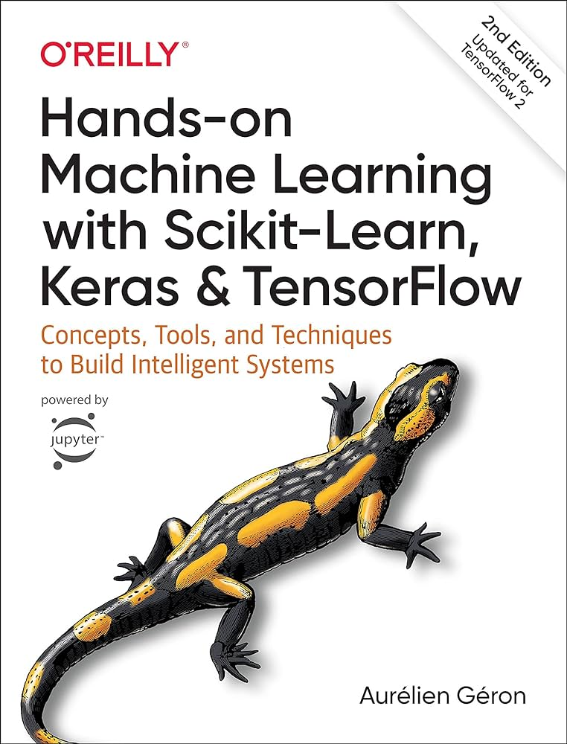
Reading Material
Hands-on machine learning with Scikit-Learn, Keras, and TensorFlow : concepts, tools, and techniques to build intelligent systems
Géron, Aurélien author.
2019
CHS 2406: Data-driven AI

Slide 8
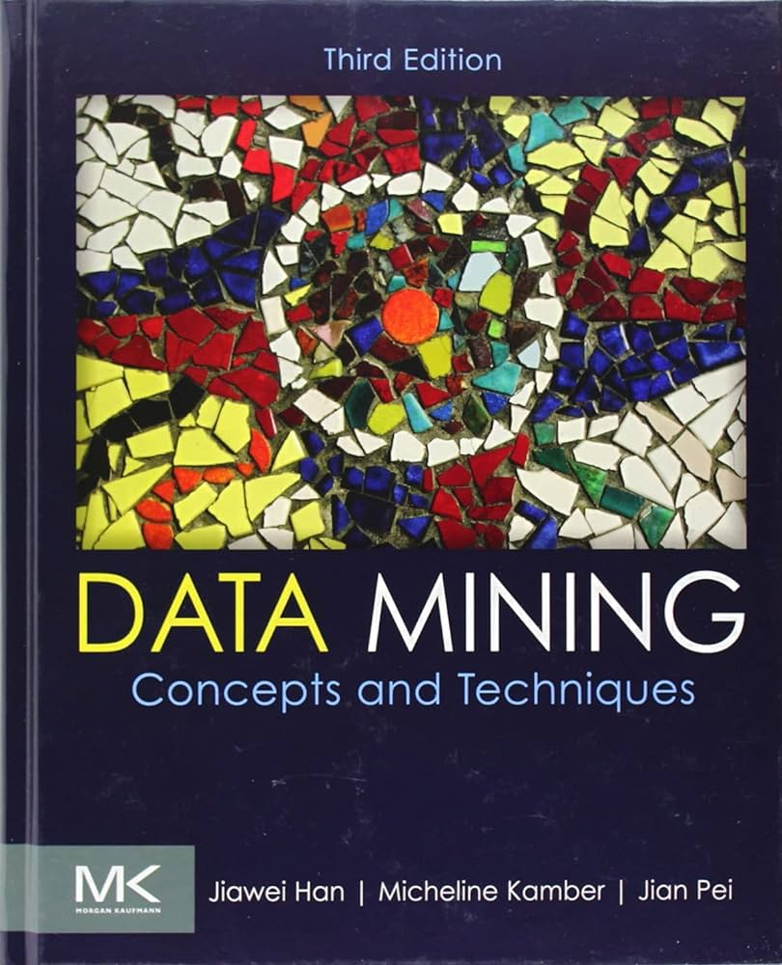
Reading Material
Data Mining
Concepts and Techniques
Fourth Edition
Jiawei Han
Jian Pei
Hanghang Tong
CHS 2406: Data-driven AI

Slide 9
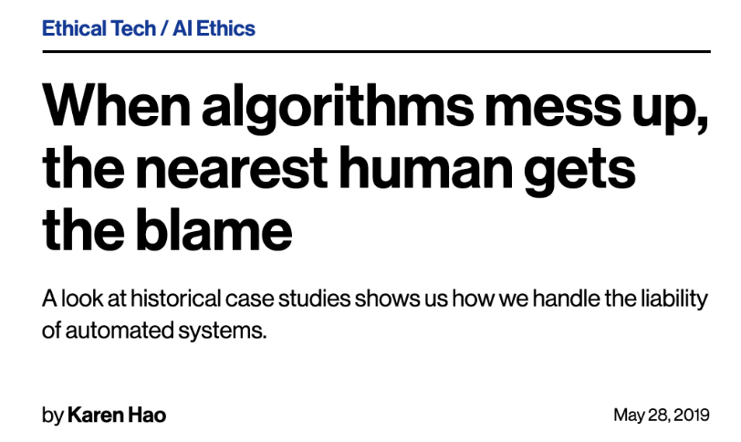
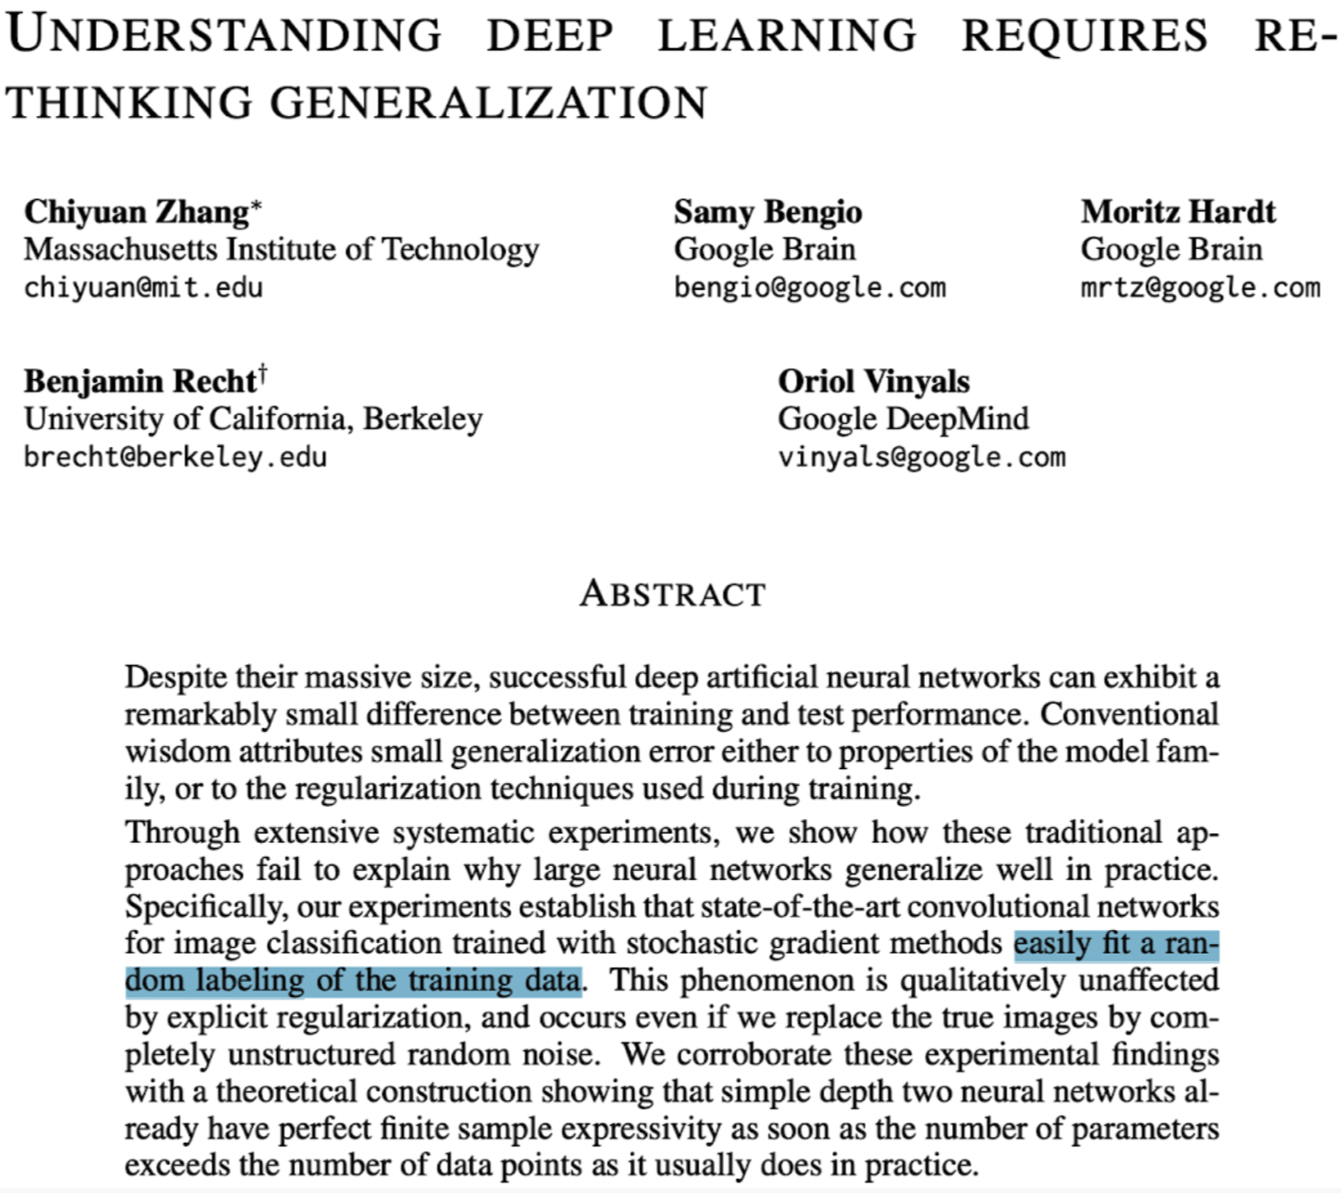
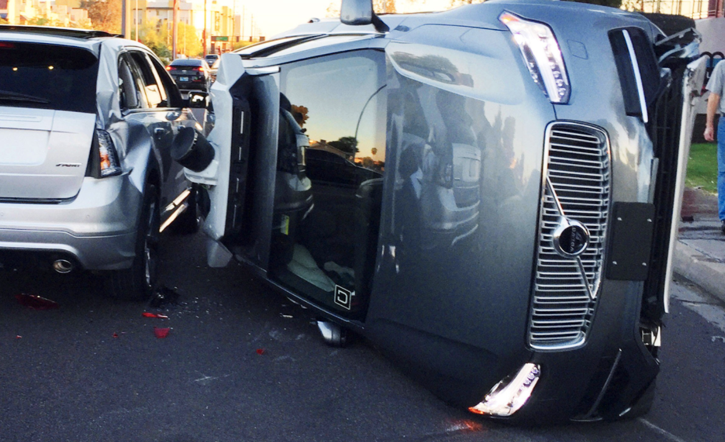
For learning, data is as important as the model
In machine learning, we tend to focus on the model
But learning depends on the quality of
the data
are trained with erroneous data`
Deep neural networks easily fit random labels.
Zhang et al. (ICLR, 2017)
Source: MIT Technology Review
(May 28, 2019)
Notes:
What should it mean for an algorithm to mess up?
Algorithms, if their assumptions are met, don’t mess up. Its the data they are trained on.
Reference: https://www.technologyreview.com/s/613578/ai-algorithms-liability-human-blame/
Most of the error they observe is actually due to dataset label quality.

Slide 10
Traditional Machine Learning is model-centric
When you learn ML techniques… a dataset is given to you, usually clean & well-curated (e.g. dog/cat images)
Your goal: produce the best model for this dataset (model-centric AI)
Techniques taught in the ML module
In traditional (model-centric) ML, you learn:
Different types of models (eg. neural architectures)
Tuning their hyperparameters
Modifying the training loss function
Regularisation

Slide 11
In many real-world ML applications, the dataset is not fixed!
Company/user does not care what clever ML tricks you used to produce accurate predictions on highly curated data.
Real-world data tends to be messy.
Ten of the most-used ML test sets have pervasive label errors. **See: https://labelerrors.com/
So, without addressing data issues, model performance remains uncertain.
Seasoned data scientist: It’s more worthwhile to invest in exploring & fixing the data than tinkering with models. (i.e. avoid “garbage in, garbage out”)
But this process is cumbersome for large datasets 😭
** Northcutt, Athalye, & Mueller, NeurIPS, 2021 (link to paper, code, errors found via cleanlab)

Slide 12
What is data-centric AI?
Emerging science of techniques to improve datasets
Data-centric AI often takes one of two forms:
AI algorithms that understand data and use that information to improve models.
e.g. Curriculum learning – train on ‘easy data’ first
Bengio et al., ICML, 2009 (link to paper)
AI algorithms that modify data to improve AI models.
e.g. Confident learning – remove wrongly-labeled data prior to training
Northcutt et al., Journal of AI Research, 2021 (link to paper)

Slide 13
Model-centric AI vs Data-centric AI
Model-centric AI:
Given a dataset, try to produce the best model
Change the model to improve performance on an AI task
e.g. modify the loss function, hyper-parameters, etc.
Data-centric AI:
Given any model, try to improve the training dataset
Systematically/algorithmically change the dataset to improve performance on an AI task

Slide 14

What is not data-centric AI?
Examples:
Hand-picking a bunch of datapoints you think will improve a model.
Double the size of your dataset and train an improved model on more data.
Data-centric AI versions:
Coreset selection
Dataset Augmentation

Slide 15
What are examples of Data-centric AI?
Outlier Detection and Removal (handling abnormal examples in dataset)
Error Detection and Correction (handling incorrect values/labels in dataset)
Data Augmentation (adding examples to data to encode prior knowledge)
Feature Engineering and Selection (manipulating how data are represented)
Establishing Consensus Labels (determining true label from crowdsourced annotations)
Active Learning (selecting the most informative data to label next)
Curriculum Learning (ordering the examples in dataset from easiest to hardest)

Slide 16
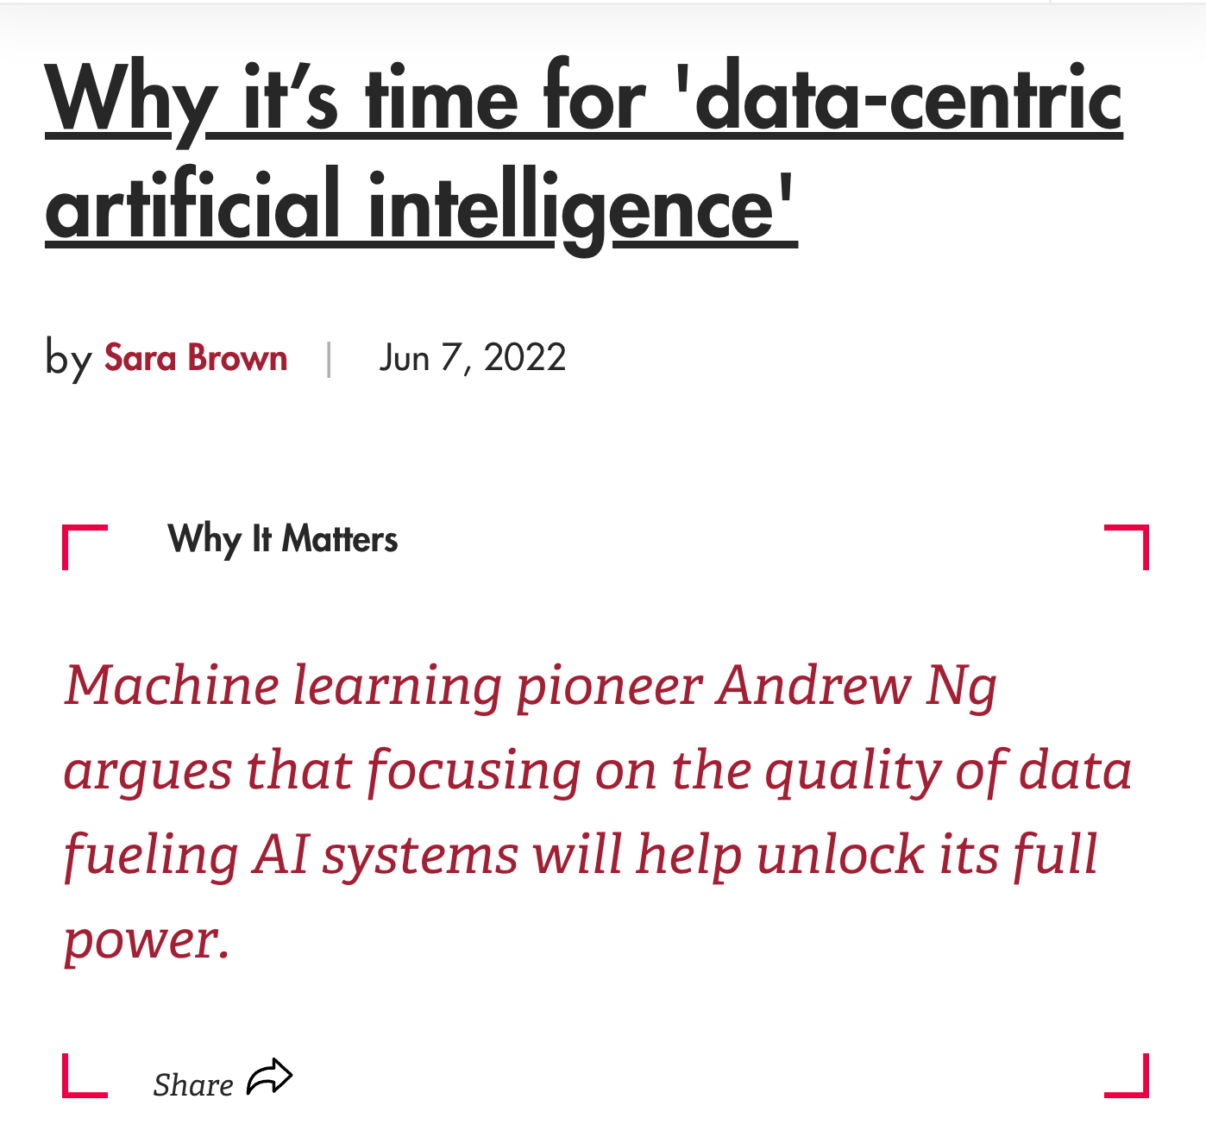
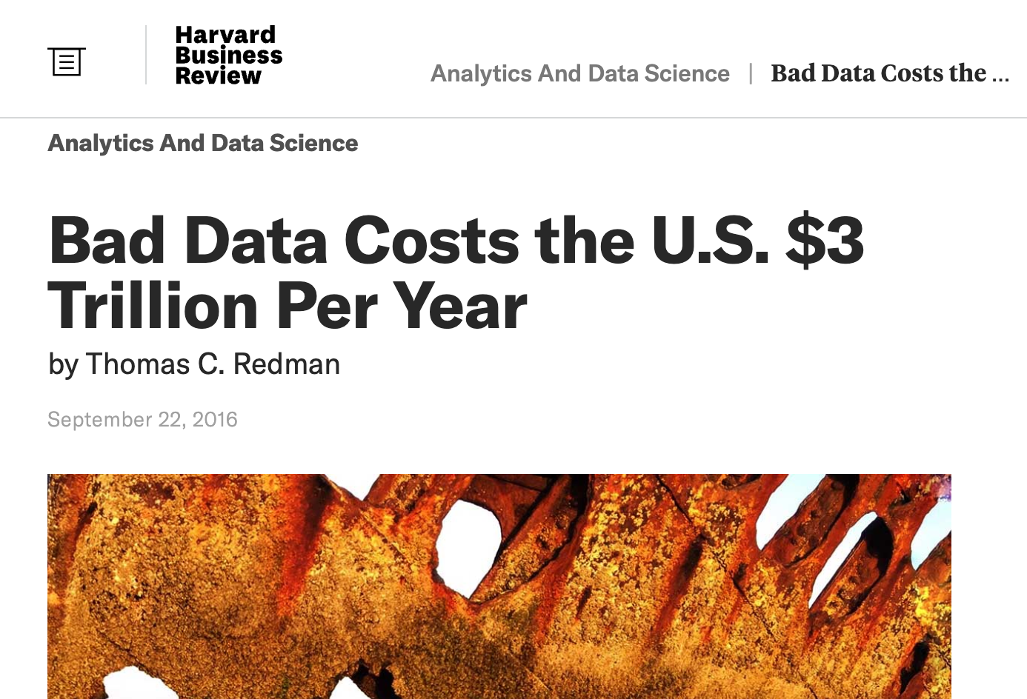
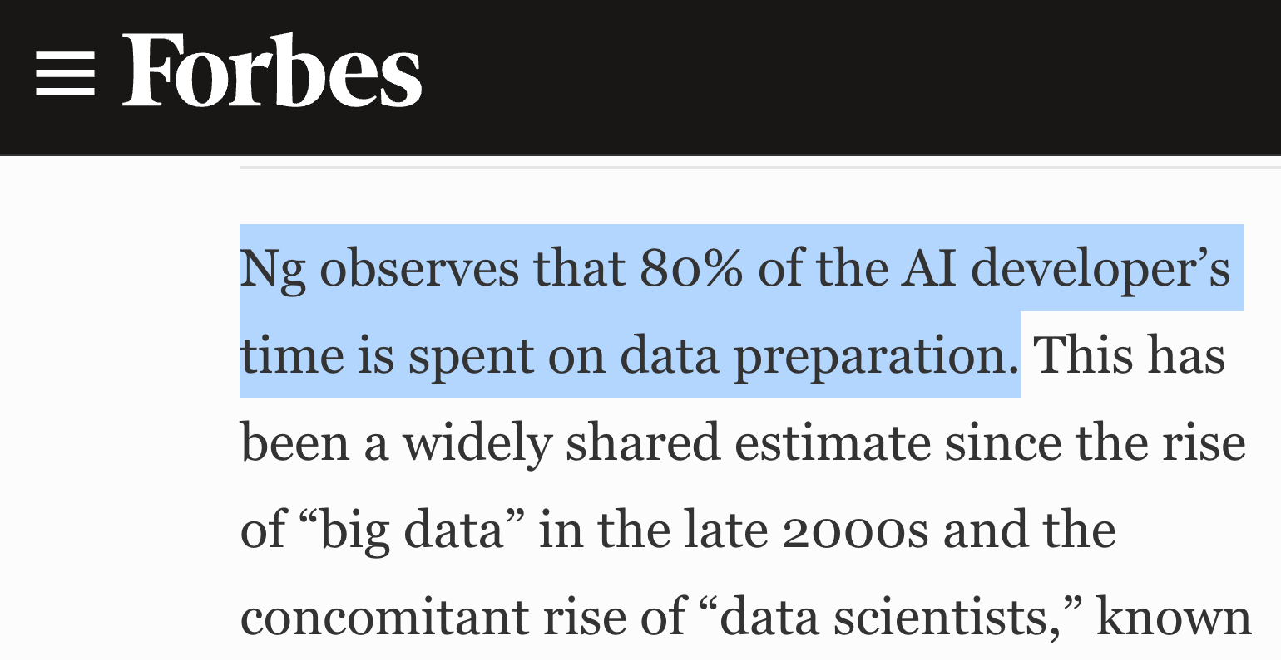
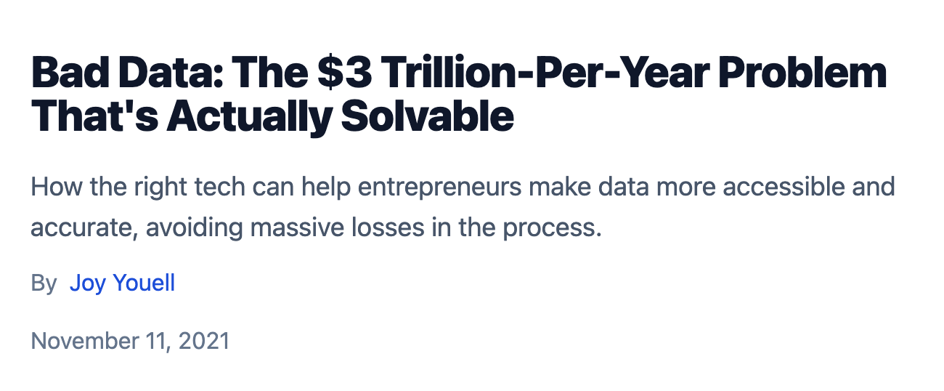
Why the hype around Data-centric AI?
Source: link
Source: link
Source: link

Slide 17
Why the hype around Data-centric AI?
OpenAI has ‘open’ly stated that one of the biggest issues with Dall-E and GPT-3 is errors in the data and labels used during training.
It’s not the model, it’s the data!
Let’s take a look at the Dall-E demo page:
https://openai.com/dall-e-2/#demos

Slide 18
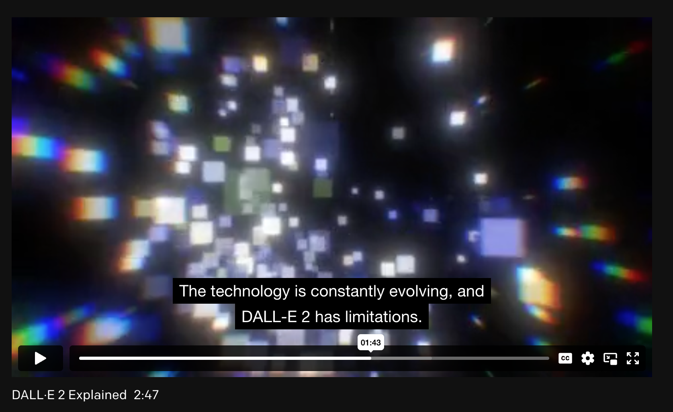
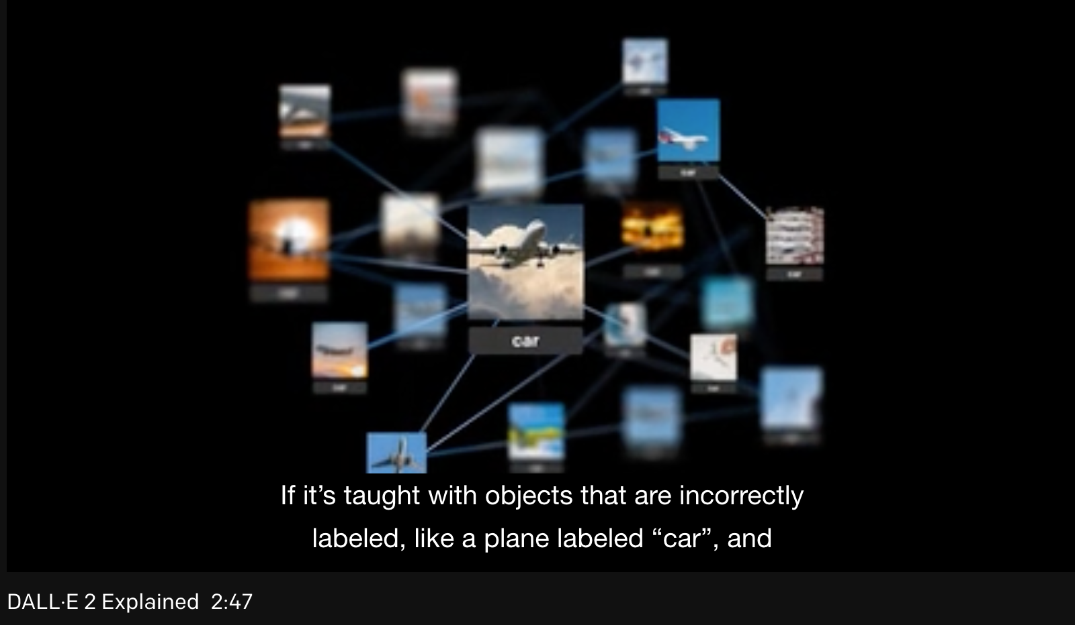
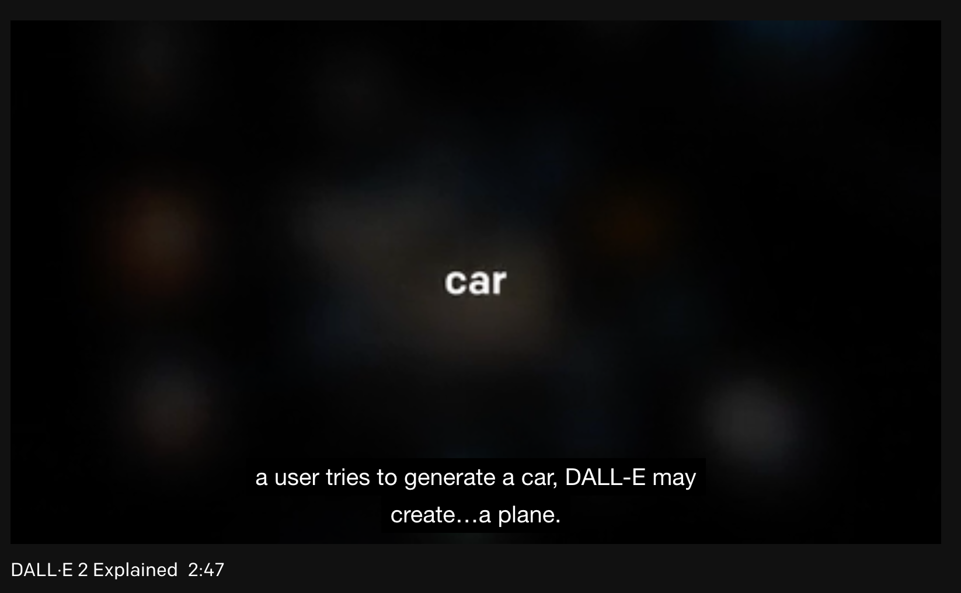
Dall-E’s big challenge → label errors at training time

Slide 19
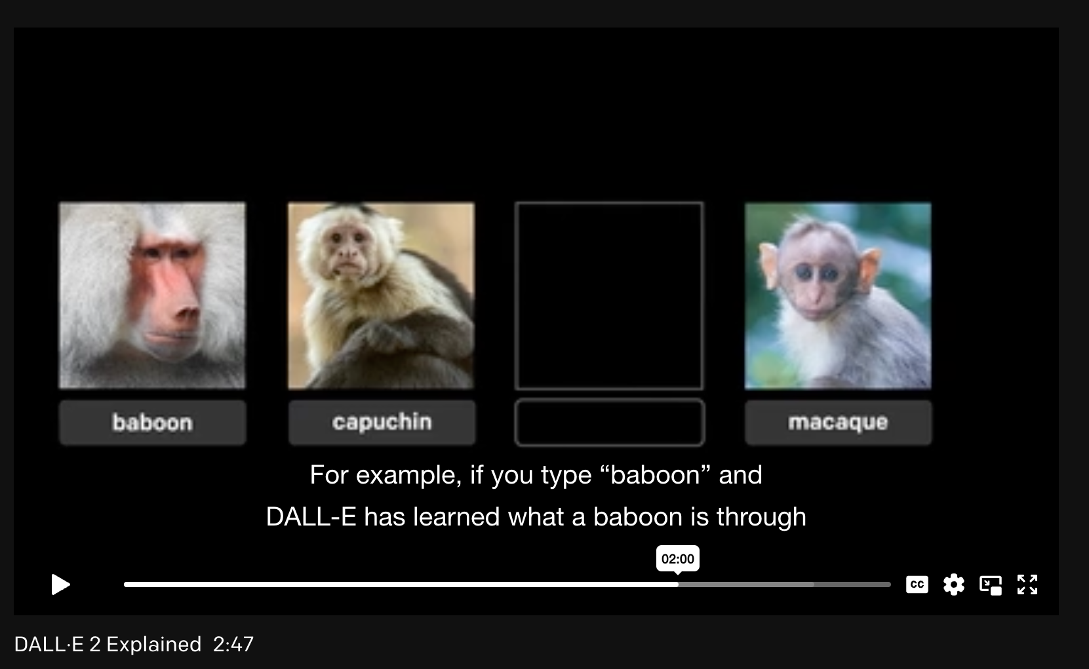
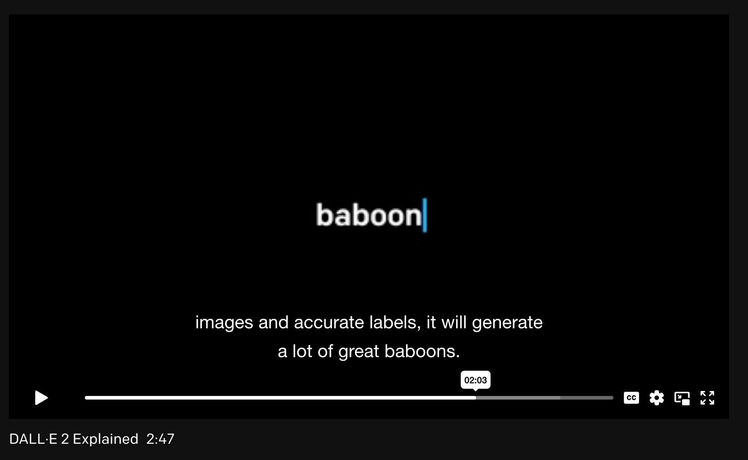
Dall-E’s big issue → label errors at training time
Take away: Reliability of ML models deployed in the real-world depends on quality of training data.

Slide 20
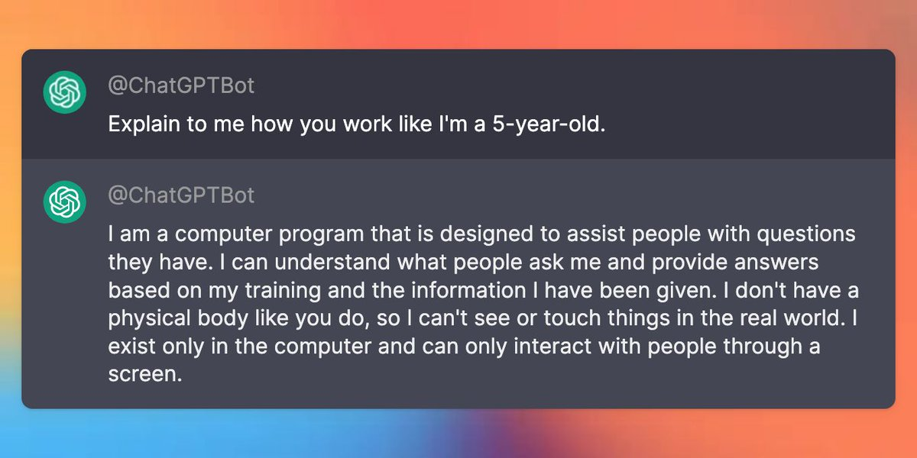
ChatGPT improved GPT-3 by improving data quality
GPT-1 to GPT-3: Rapid scaling of model size, improving the fluency and coherence of generated text.
GPT-3.5 and GPT-4: Improved contextual understanding, reasoning, and conversational abilities.
GPT-4 (and Turbo): Multimodal processing, allowing the model to work with images as well as text, and focusing on faster, more efficient responses.
ChatGPT was fine-tuned to:
Minimize harmful, untruthful, or biased output
Used human rankings of potential outputs to put lower-weighting on ‘bad data’
Link to source. Link to blog.

Slide 21
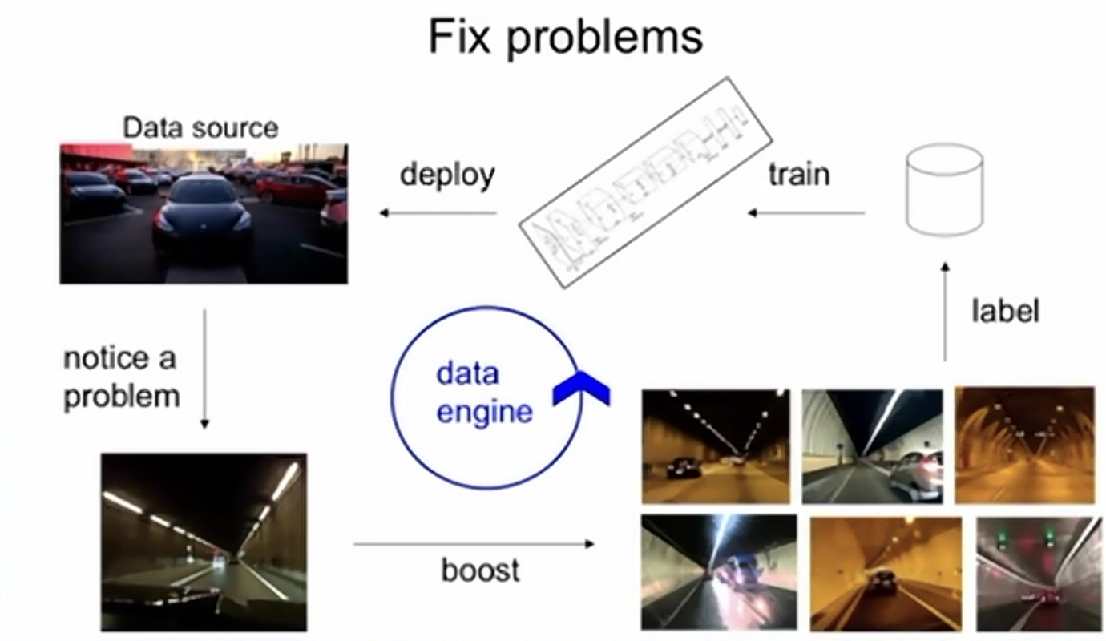
Tesla Data Engine: use model outputs to improve training dataset
Slide from Andrej Karpathy, Tesla Director of AI (2021)

Slide 22
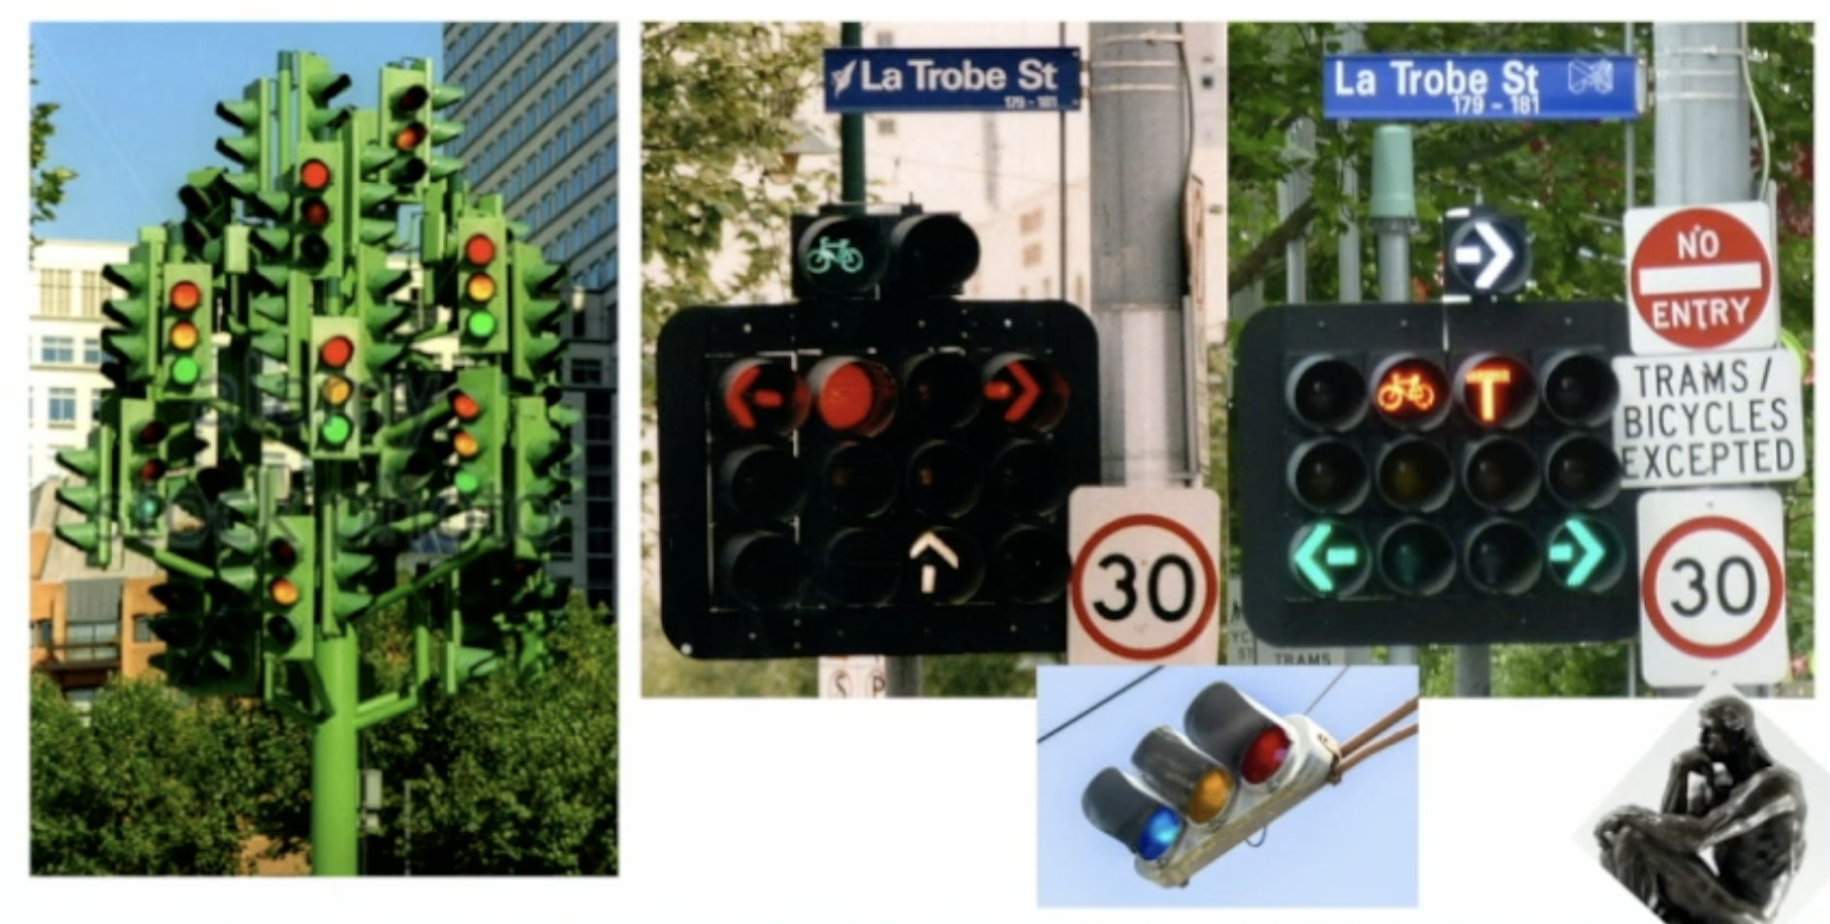
Tesla Data Engine: use model outputs to improve training dataset
Slide from Andrej Karpathy, Tesla Director of AI (2021)

Slide 23
Before there was data-centric AI…
We relied on mostly-human-powered solutions to improve dataset quality:
Spend more cost for higher quality data or more labels
Build custom tools to evaluate specific data (e.g. Tesla data quality platform)
Fixing data inside a Jupyter notebook
Data-driven AI = systematising these approaches to be more reliable, accurate, and generally usable on many datasets.

Slide 24
A Programming Example for Model-centric and Data-centric AI Approaches

Slide 25
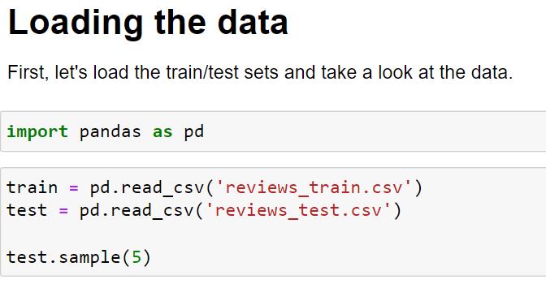

Slide 26
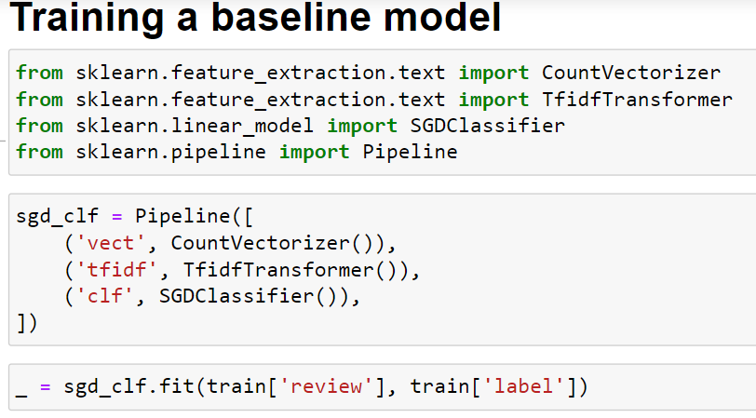

Slide 27
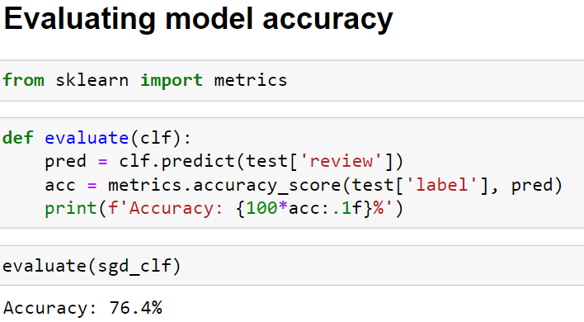

Slide 28
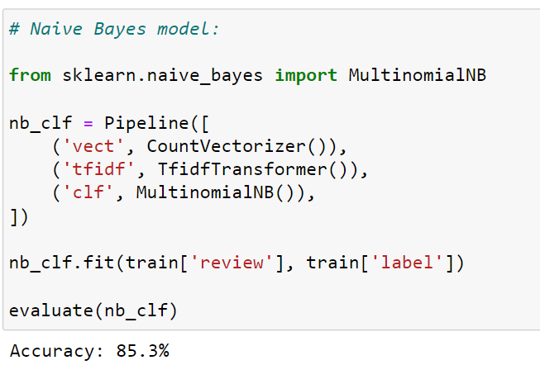

Slide 29
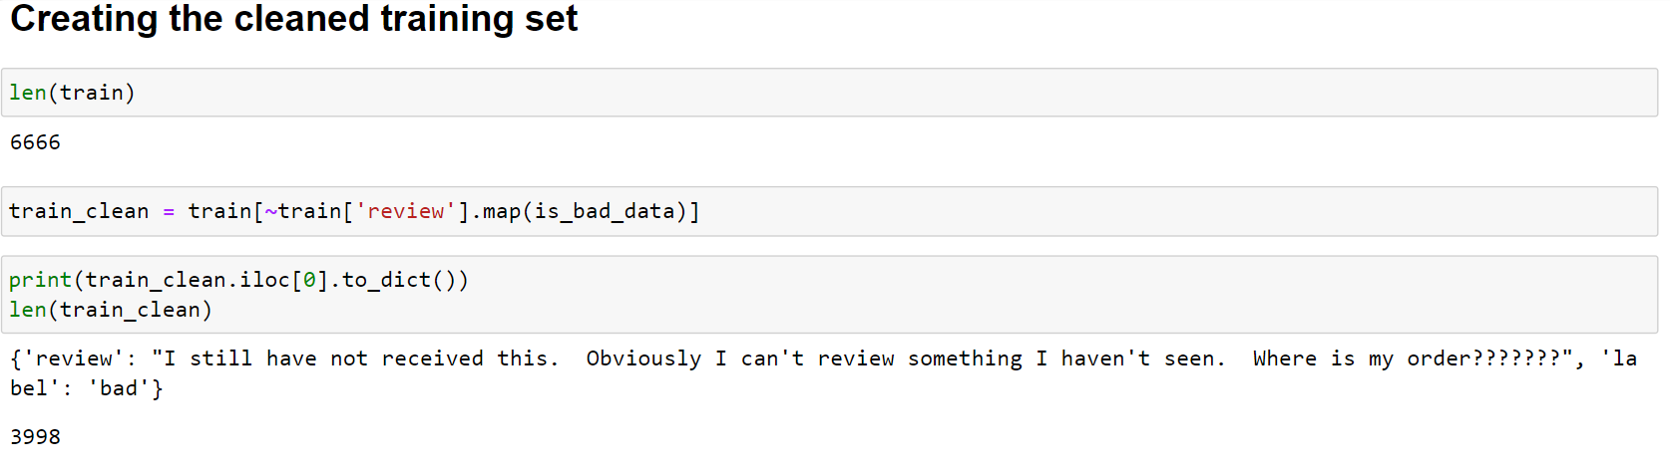

Slide 30
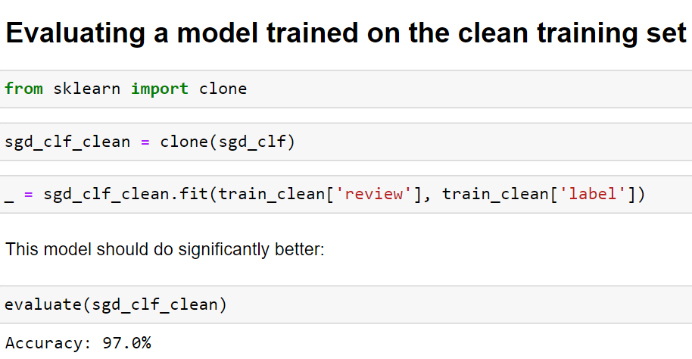

Slide 31


Data-centric vs model-centric for learning with noisy labels
Base model Accuracy: 76%
Model-Centric AI
Accuracy: 85%
Data-Centric AI
Accuracy: 97%
12%
28%

Slide 32
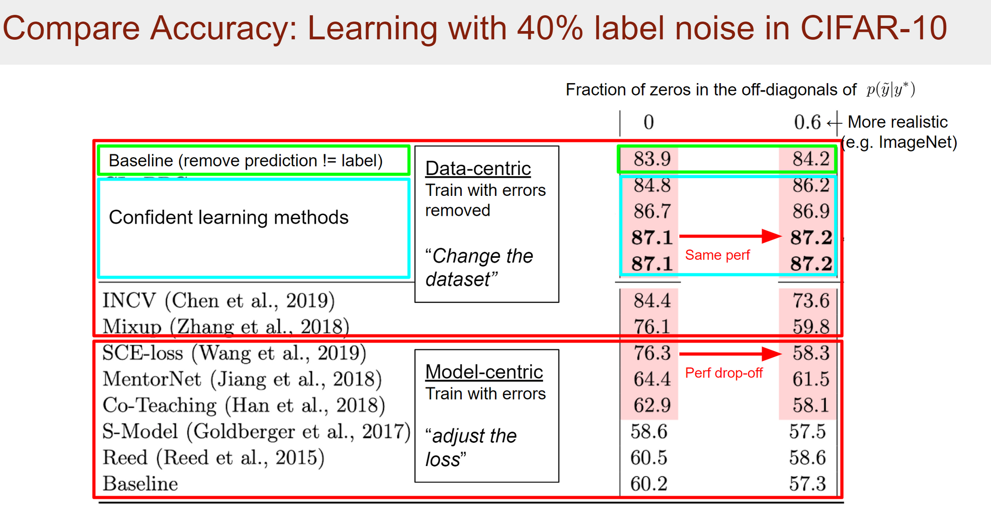
Data-centric vs model-centric for learning with noisy labels
Northcutt et al., JAIR, 2021
“Confident Learning” (link to paper)

Slide 33

Quick Recap
Questions for
Reflection

Slide 34
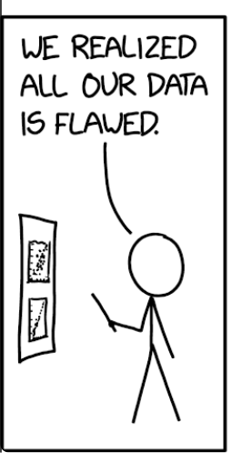
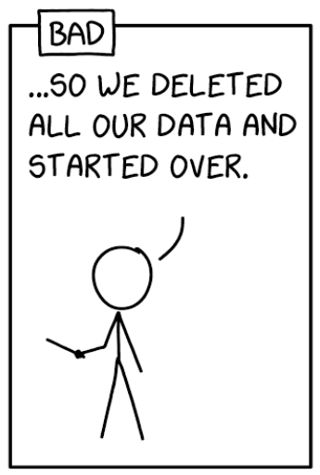
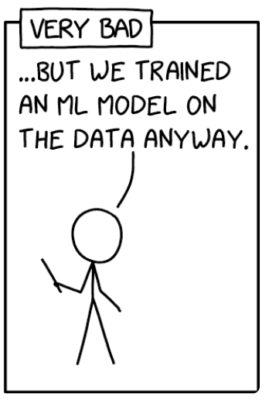
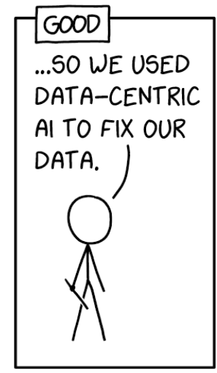
Choose the appropriate comment
(BAD, VERY BAD, OR GOOD)
for the following
1
2
3

Slide 35
Inspired by XKCD 2494 “Flawed Data”

Slide 36


